Slide 1
Preventing and Treating Sexually Transmitted Diseases

Slide 2
Anonymous Questions
Write down any question you have about STDs.
Guidelines:
Everyone must turn one in, even if it’s just a comment
Please be quiet and respectful
Do not write your name down
Collected at the end

Slide 4
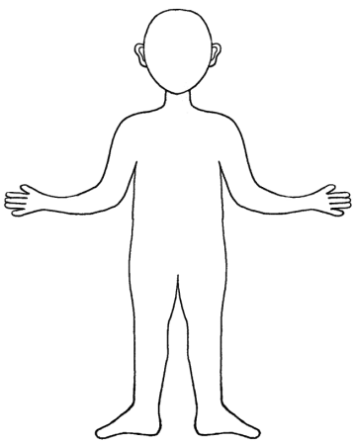
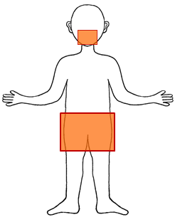
The Two Modes of STD Transmission
Skin to Skin
Infected Skin + Susceptible Skin
Body Fluids
Infected Body Fluid + Point of Entry
TRANSMISSION
of INFECTION

Slide 5
STD Transmission
Skin to Skin
Body Fluid
Pubic Lice
Herpes
Human Papilloma Virus (HPV can cause genital warts and cancer)
Syphilis
Chlamydia
Gonorrhea
Trichomoniasis
Hepatitis B
Hepatitis C
HIV (the virus that can cause AIDS)

Slide 6
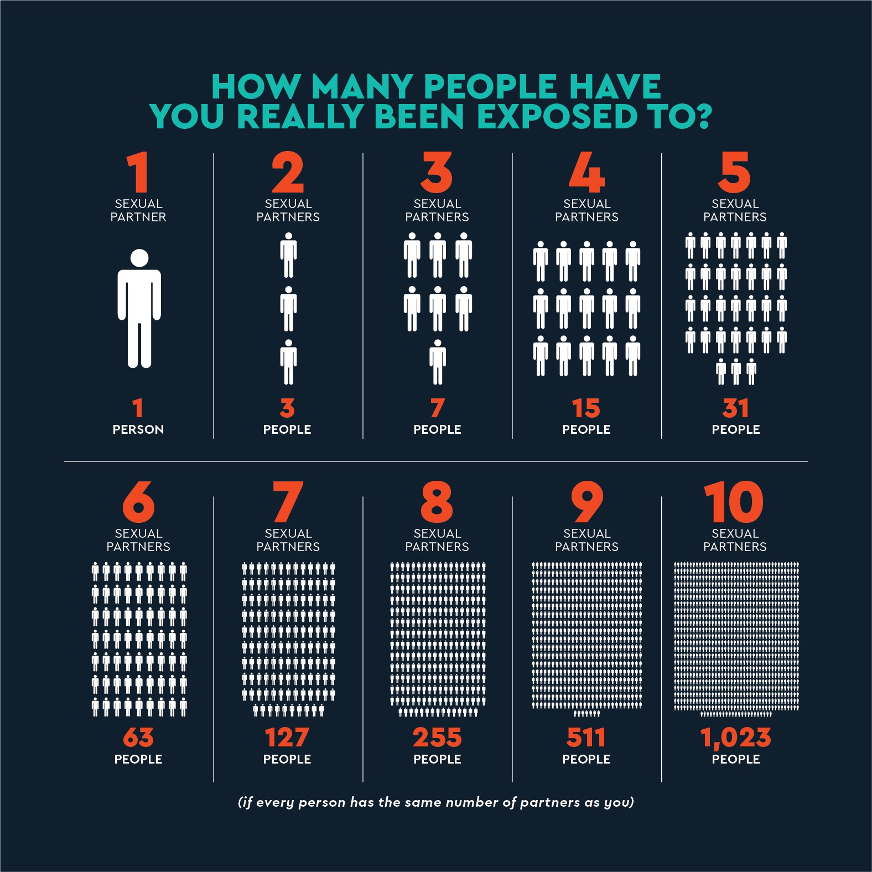

Slide 7
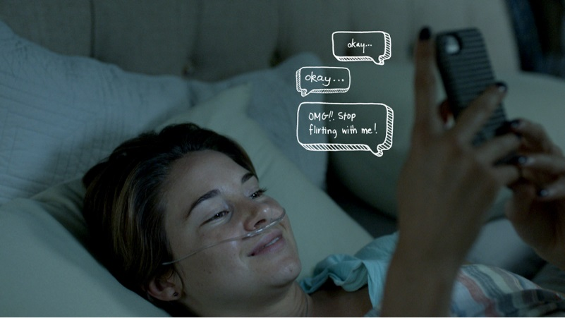
Let’s talk…
Open Communication

Slide 8
STD Testing
STEP 1: Get there!

Slide 9
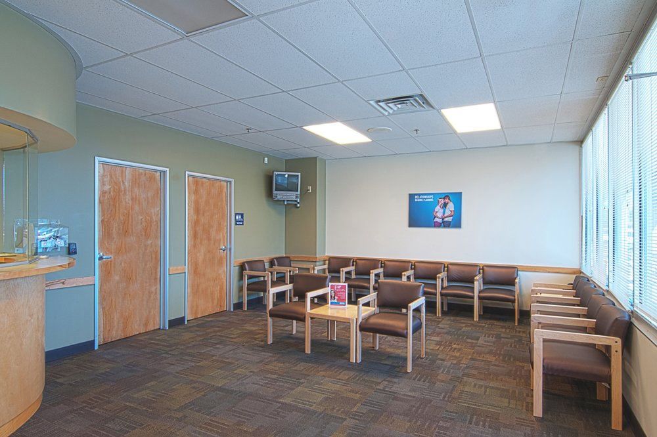
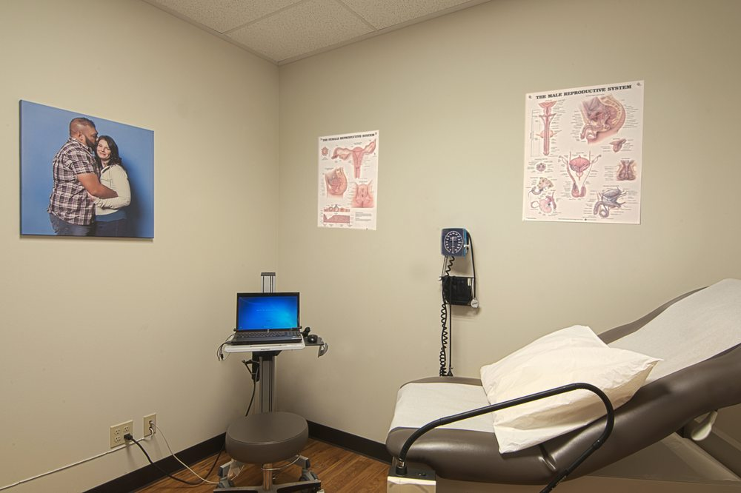
STD Testing
STEP 2: The Questions!

Slide 10
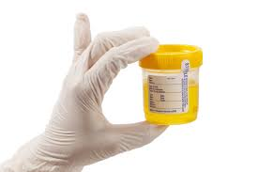
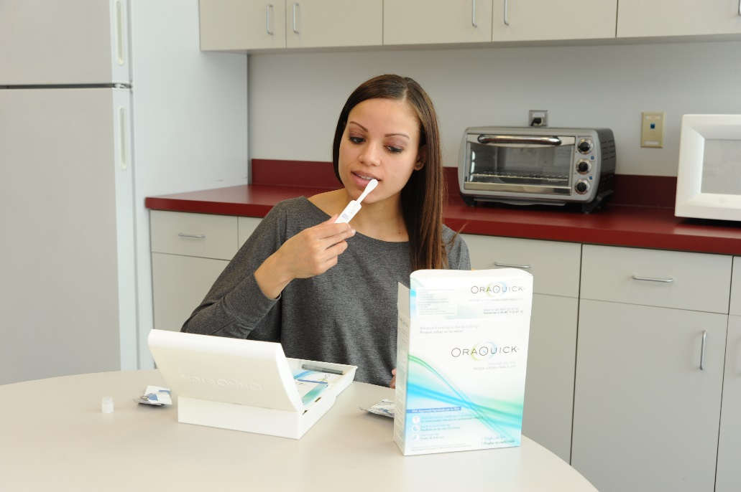
STD Testing
STEP 3: The Tests!

Slide 11
STD Testing
STEP 4: The Results!

Slide 12
Curable or Treatable?
These STDs can be cured:
These STDs are treatable:
Crabs/Pubic Lice
Syphilis
Chlamydia
Gonorrhea
Trichomoniasis
Hepatitis C
Herpes
Human Papillomavirus (HPV) – can cause genital warts or cervical cancer
Hepatitis B
HIV/AIDS

Slide 13
Some solid reasons to get tested…
You deserve to know!
Your partners deserve to know!
Many STDs have no symptoms, so it may be the only way to know
It is easy, painless, and safe
It can be confidential
If you do test positive, you can receive timely and more effective treatment

Slide 14
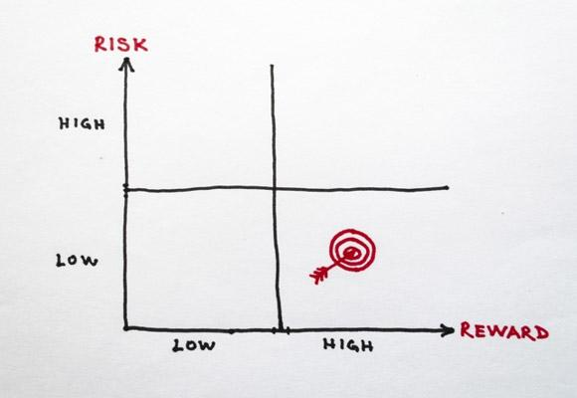
Many ways to prevent and reduce risk…
Abstain or delay sex
Use barrier methods (condoms, dental dams)
Limit number of sexual partners
Get vaccinated
Increase knowledge
Get tested (regularly)
Talk openly and honestly

Slide 15
Additional Resources
Where to Test:
For More Info:
Family Health Services-Bellevue
621 N Main St Bellevue
(208) 725-3145
Ketchum Family Medicine-Ashley Brown
(208) 622-3180
St. Luke’s Clinic
1450 Aviation Dr. Suite 100 Hailey
Call: (208) 788-3434
Twin Falls Planned Parenthood
200 Second Ave N. Twin Falls
Call: 1-800-769-0045
Center for Disease Control
http://cdc.gov/std/
For general information about STDs
Sex Etc.
www.sexetc.org
For Teens, By Teens! Info about relationships, sex, consent, STDs, etc.
Planned Parenthood
www.plannedparenthood.org
Answers about pregnancy, birth control, emergency contraception, STDs, and more…
This Photo by Unknown Author is licensed under CC BY-NC-SA

Slide 16
QUESTIONS?

